Slide 1

Random Forests

Slide 2
Random Forests
Random Forests have the ability to greatly increase the performance based on expanding ideas from the Decision Tree.
Random Forests are known as ensemble learners, since they rely on an ensemble of models (multiple decision trees).

Slide 3
Random Forests
Section Overview:
Motivation and History
Hyperparameters
Random Forest Classification
Random Forest Regression
Comparing many regression models (SVR, DTR, etc…)

Slide 4
Let’s get started!

Slide 5
Random Forests
Theory and Intuition: Motivation and History

Slide 6
Random Forests
Why not just continue to use Decision Trees?
What is the motivation behind Random Forests and how do they improve on Decision Trees?
Let’s think back to the construction of a single decision tree...

Slide 7
Random Forests
Imagine a data set with features and label:

Slide 8
Random Forests
Imagine a data set with features and label:
Y

Slide 9
Random Forests
Decision Tree restricted by gini impurity:
Y

Slide 10
Random Forests
Decision Tree restricted by gini impurity:
Y

Slide 11
Random Forests
No guarantee of using all features!
Y

Slide 12
Random Forests
Root node will always be the same!
Y

Slide 13
Random Forests
Root feature has huge influence over tree.
Y

Slide 14
Random Forests
We could try adjusting rules, such as:
Splitting Criterion (Information Gain)
Minimum Gini Impurity Decrease
Setting Depth Limits
Limits on number of terminal leaf nodes

Slide 15
Random Forests
However even with all these added hyperparameter adjustments, the single decision tree is still limited:
Single feature for root node.
Splitting criteria can lead to some features not being used.
Potential for overfitting to data.

Slide 16

Random Forests
1995: Tin Kam Ho presents Random Decision Forests at the 3rd International Conference on Document Analysis and Recognition in Montreal.

Slide 17
Random Forests
Y

Slide 18
Random Forests
Y

Slide 19
Random Forests
Y

Slide 20
Random Forests
Y

Slide 21
Random Forests
Y

Slide 22
Random Forests
Y

Slide 23
Random Forests
Y
Create subsets of randomly picked features at each potential split

Slide 24
Random Forests
Y

Slide 25
Random Forests
Y

Slide 26
Random Forests
Y

Slide 27
Random Forests
Y

Slide 28
Random Forests
Y

Slide 29
Random Forests
Y

Slide 30
Random Forests
Y

Slide 31
Random Forests
Y

Slide 32
Random Forests
Y

Slide 33
Random Forests
Y

Slide 34
Random Forests
Y

Slide 35
Random Forests
Y

Slide 36
Random Forests
Y

Slide 37
Random Forests
Y

Slide 38
Random Forests
Y

Slide 39
Random Forests
Tree 1 : Y == 0
Tree 2 : Y == 0
Tree 3 : Y == 1
(0,0,1)
Y == 0

Slide 40
Random Forests
Tree 1 : Y == 10
Tree 2 : Y == 13
Tree 3 : Y == 11
(10,13,11)
Y == 11.3

Slide 41
Random Forests
Ho and other researchers showed that adding the random feature subspace constraint could allow trees to grow much deeper without causing overfitting.
Mathematical explanation of this was shown by Eugene Kleinberg's theory of stochastic discrimination.

Slide 42
Random Forests
2001: Leo Breiman publishes Random Forests in the journal Machine Learning.
Introduces bootstrapping samples and out of bag error.

Slide 43
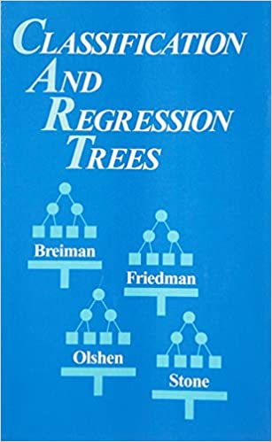
Random Forests
2001: Leo Breiman publishes Random Forests in the journal Machine Learning.
Introduces bootstrapping samples and out of bag error.

Slide 44
Random Forests
Let’s further explore how Random Forests expand on decision trees by creating an ensemble of estimators (multiple decision trees).
We will look directly at Scikit-Learn’s Random Forest class call and see what additional hyperparameters we have compared to a single decision tree.

Slide 45
Random Forests
Theory and Intuition: Hyperparameters

Slide 46
Random Forests
Since a Random Forest is an ensemble of many decision trees, many of the hyperparameters between both models are shared.
Let’s explore the important hyperparameters unique to a Random Forest.

Slide 47
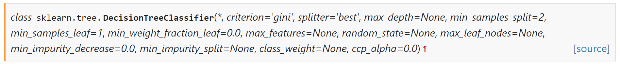
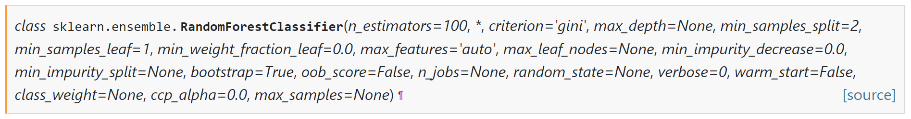
Random Forests

Slide 48
Random Forests

Slide 49
Random Forests

Slide 50
Random Forests

Slide 51
Random Forests
Random Forest Hyperparameters:
Number of Estimators
Number of Features
Bootstrap Samples
Out-of-Bag Error

Slide 52
Random Forests
Random Forest Hyperparameters:
Number of Estimators
How many decision trees to use total in forest?
Number of Features
How many features to include in each subset?

Slide 53
Random Forests
Random Forest Hyperparameters:
Bootstrap Samples
Allow for bootstrap sampling of each training subset of features?
Out-of-Bag Error
Calculate OOB error during training?

Slide 54
Random Forests
Let’s explore these hyperparameters in the next series of lectures!

Slide 55
Random Forests
Theory and Intuition: Hyperparameters
Number of Estimators and Features

Slide 56
Random Forests
Random Forest Hyperparameters:
Number of Estimators
How many decision trees to use total in forest?
Number of Features
How many features to include in each subset?

Slide 57
Random Forests
Number of Estimators
Intuitively, we know the more decision trees, the more opportunities to learn from a variety of feature subset combinations.
Is there a limit to adding more trees?
Is there a danger of overfitting?

Slide 58
Random Forests
From Leo Breiman’s official page on Random Forests:
“Random forests does not overfit. You can run as many trees as you want. It is fast.”
www.stat.berkeley.edu/~breiman/RandomForests/cc_home.htm#remarks

Slide 59
Random Forests
How to choose number of trees?
Reasonable Default Value: 100
Publications suggest 64-128 trees.
Cross Validate a grid search of trees.
Plot Error versus number of trees (similar to elbow method of KNN).
Should notice diminishing error reduction after some N trees.

Slide 60
Random Forests
Error vs. Trees
Error
Number of Estimators (Trees)

Slide 61
Random Forests
Error vs. Trees
Error
Number of Estimators (Trees)

Slide 62
Random Forests
After a certain number of trees, two things that can occur:
Different random selections don’t reveal any more information.
Trees become highly correlated.
Different random selections are simply duplicating trees that have already been created.

Slide 63
Random Forests
This allows us to be quite lenient in setting number of estimators hyperparameters, as overfitting is of minimal concern.
Now let’s discuss how to choose the number of features to randomly select at each split.

Slide 64
Random Forests
Random Forest Hyperparameters:
Number of Features
How many features to include in each subset when splitting at a node?

Slide 65
Random Forests
Number of Features in Subset?
Original Publication suggested subset of log₂(N+1) random features in subset given a set of N total features.

Slide 66
Random Forests
From Leo Breiman’s official page on Random Forests:
“An interesting difference between regression and classification is that the correlation increases quite slowly as the number of features used increases.”
www.stat.berkeley.edu/~breiman/RandomForests/cc_home.htm#remarks

Slide 67
Random Forests
Number of Features in Subset?
Current suggested convention is sqrt(N) in the subset given N features.
Later suggestions by Breiman indicated N/3 may be more suitable for regression tasks, typically larger than sqrt(N).

Slide 68
Random Forests
Number of Features in Subset?
ISLR indicates this should be treated as a tuning parameter, with sqrt(N) as a good starting point.
All the previous options shown were explored using empirical methods, so it is likely you will need to adjust based on your specific dataset.

Slide 69
Random Forests
Hyperparameter Review:
Number of Estimators:
Start with 100 as default, feel free to grid search for higher values.
Number of Features for Selection:
Start with sqrt(N), grid search for other possible values (N/3).

Slide 70
Random Forests
Now let’s move on to exploring Bootstrapping and Out-of-Bag Error!

Slide 71
Random Forests
Theory and Intuition: Hyperparameters
Bootstrap Samples and OOB Error

Slide 72
Random Forests
Random Forest Hyperparameters:
Bootstrap Samples
Allow for bootstrap sampling of each training subset of features?
Out-of-Bag Error
Calculate OOB error during training?

Slide 73
Random Forests
Bootstrap Samples
Allow for bootstrap sampling of each training subset of features?
First, let’s understand “bootstrapping” in general terms...

Slide 74
Random Forests
What is Bootstrapping?
A term used to describe “random sampling with replacement”.
Let’s see a quick example given a set of letters…

Slide 75
Random Forests
What is Bootstrapping?
A
B
C
D
E

Slide 76
Random Forests
What is Bootstrapping?
A
B
C
D
E

Slide 77
Random Forests
What is Bootstrapping?
A
B
C
D
E
C

Slide 78
Random Forests
What is Bootstrapping?
A
B
C
D
E
C | A

Slide 79
Random Forests
What is Bootstrapping?
A
B
C
D
E
C | A | D

Slide 80
Random Forests
What is Bootstrapping?
A
B
C
D
E
C | A | D | C

Slide 81
Random Forests
What is Bootstrapping?
A
B
C
D
E
C | A | D | C

Slide 82
Random Forests
What is Bootstrapping?
A
B
C
D
E
C | A | D | C | E | D | A | B | B | C

Slide 83
Random Forests
Bootstrapping in Random Forest
Recall for each split we are randomly selecting a subset of features.
This random subset of features helps create more diverse trees that are not correlated to each other.

Slide 84
Random Forests
Y

Slide 85
Random Forests
Bootstrapping in Random Forest
To further differentiate trees, we could bootstrap a selection of rows for each split.
This results in two randomized training components:
Subset of Features Used
Bootstrapped rows of data

Slide 86
Random Forests
0
1
2
3
4
5
6
Y

Slide 87
Random Forests
0
1
2
3
4
5
6
Y

Slide 88
Random Forests
0
1
2
3
4
5
6
Y
2
5
3
5
1

Slide 89
Random Forests
Bootstrapping can be set to False during training (it is True by default).
Bootstrapping is yet another hyperparameter meant to reduce correlation between trees, since trees are then trained on different subsets of feature columns and data rows!

Slide 90
Random Forests
Random Forest Hyperparameters:
Out-of-Bag Error
Calculate OOB error during training?

Slide 91
Random Forests
What is Bagging?
Recall to actually use a Random Forest, we use bootstrapped data and then calculate a prediction based on the aggregated prediction of the trees:
Classification: Most Voted Y Class
Regression: Average Predicted Ys

Slide 92
Random Forests
What is Bagging?
Recall to actually use a Random Forest, we use bootstrapped data and then calculate a prediction based on the aggregated prediction of the trees:
Classification: Most Voted Y Class
Regression: Average Predicted Ys

Slide 93
Random Forests
What is Bagging?
If we performed bootstrapping when building out trees, this means that for certain trees, certain rows of data were not used for training.

Slide 94
Random Forests
0
1
2
3
4
5
6
Y
2
5
3
5
1

Slide 95
Random Forests
0
1
2
3
4
5
6
Y

Slide 96
Random Forests
0
1
2
3
4
5
6
Y
2
5
3
5
1

Slide 97
Random Forests
0
1
2
3
4
5
6
Y
2
5
3
5
1

Slide 98
Random Forests
Out-of-Bag Samples
Not used for constructing some trees.
We could use these to get performance test metrics on trees that did not use these rows!
0
1
2
3
4
5
6
Y

Slide 99
Random Forests
0
1
2
3
4
5
6
Y
0
4
6

Slide 100
Random Forests
0
1
2
3
4
5
6
Y
0
4
6

Slide 101
Random Forests
0
1
2
3
4
5
6
Y
0
4
6
ŷ
y

Slide 102
Random Forests
0
1
2
3
4
5
6
Y
0
4
6
ŷ
y
OOB Error

Slide 103
Random Forests
Note that OOB Score is a hyperparameter that doesn’t really affect training process.
It is separate from bootstrapping, OOB Score is an optional way of measuring performance, an alternative to using a standard train/test split, since bootstrapping naturally results in unused data during training.

Slide 104
Random Forests
Note that OOB Score is also limited to not using all the trees in the random forest, it can only be calculated on trees that did not use the OOB data!
Due to not using the entire random forest, the default value of OOB Score hyperparameter is set to False.

Slide 105
Random Forests
We now understand the theory and intuition behind Random Forests and the specific hyperparameters we can adjust.
Let’s move on to exploring how to use Random Forests for Classification and Regression!

Slide 106
Random Forests
Coding Classification - Part One
Simple Random Forest Example

Slide 107
Random Forests
Let’s revisit our penguin data set, but now use the Random Forest classifier.
Afterwards, we’ll move on to a larger banknote authentication data set to explore hyperparameters like number of estimators and bootstrapping through a grid search.

Slide 108
Random Forests
Coding Classification - Part Two
Random Forest with Grid Search

Slide 109
Random Forests
Now we’ll explore a larger data set to walk through a more realistic work flow of using Random Forest which would involve a GridSearch with Cross-Validation.
We will use the popular banknote authentication data set from the UC Irvine ML Data Repository.

Slide 110

Random Forests
Banknote Authentication Dataset
Real and fake bills scanned and a wavelet transformation was performed on the image.

Slide 111
Random Forests
Banknote Authentication Dataset Features:
Variance of Wavelet Transformation
Skewness of Wavelet Transformation
Curtosis of Wavelet Transformation
Entropy of Image

Slide 112
Random Forests
Regression Lecture Series Overview

Slide 113
Random Forests
Let’s now explore a regression task (continuous label) with Random Forest.
We will also compare Random Forest Regression with a wide variety of other regression models!

Slide 114
Random Forests
Data - Tunnel Boring
We will be working with some artificial data modelling X-ray signal versus rock density.
Let’s get a quick idea of what situation this is modelling.

Slide 115

Random Forests
Boring a new tunnel into rock

Slide 116
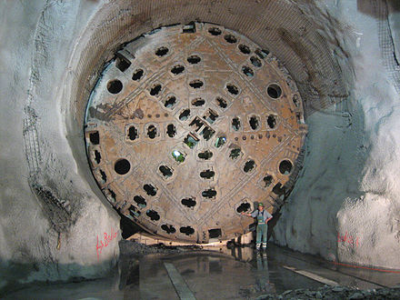
Random Forests
Using large tunnel boring machine

Slide 117
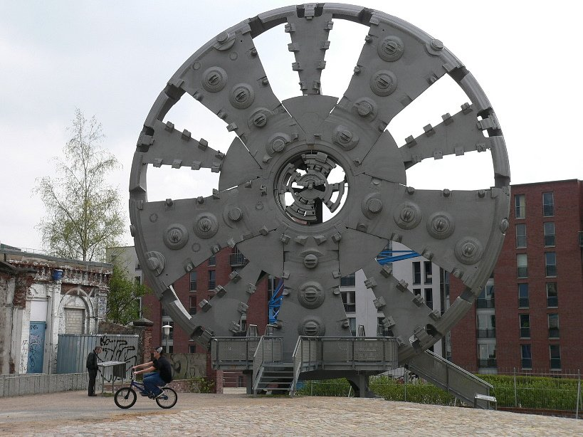
Random Forests
Boring machines can have different cutting shields depending on the rock density:

Slide 118
Random Forests
Use X-ray signals to determine rock density.
Based on a rebound signal strength in nHz, we can estimate a density of rock in kg/m³.
We have some experimental results based on lab tests on a variety of rock samples.

Slide 119
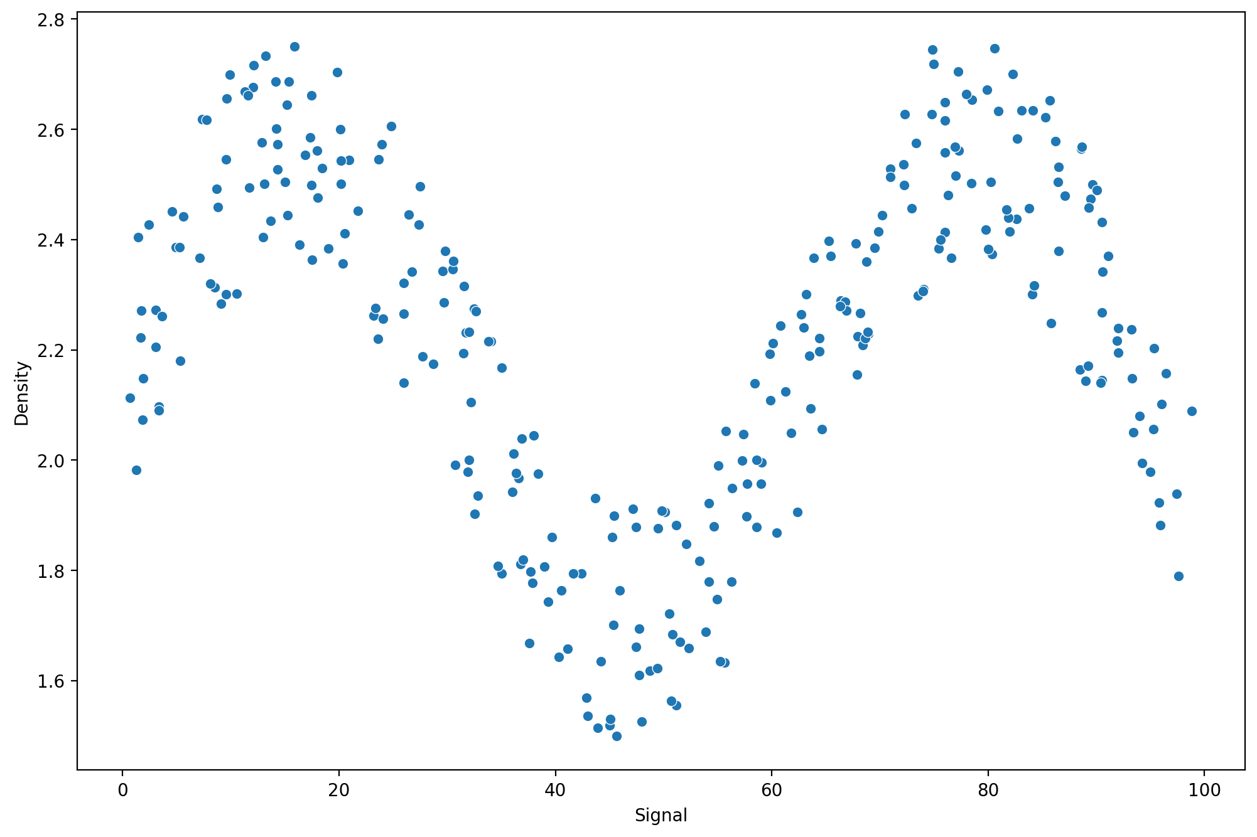
Random Forests
Resulting data looks like this:

Slide 120
Random Forests
Our goal is to build a generalized model, which we could then use to accept a rebound signal, and output an expected rock density.

Slide 121
Random Forests
Example model on top of data:

Slide 122
Random Forests
This generalized model would allow us to go out in the field, take a rebound signal measurement, and then report back an expected rock density value.
For this lecture series, we will be comparing a variety of regression models against each other.

Slide 123
Random Forests
Models Explored:
Linear Regression
Polynomial Regression
KNN Regression
Decision Tree Regression
Support Vector Regression
Boosted Trees Regression
Random Forest Regression

Slide 124
Random Forests
Things to keep in mind:
Similar to our first studies on Linear Regression, we simply need our model to predict output for the expected range of rebound signal.
We’ll create prediction outputs for an expected signal range (0nHz-100nHz)

Slide 125
Random Forests
Things to keep in mind:
We will be able to easily visualize model output to compare regression outputs.
Keep this in mind as you compare outputs (e.g. smoothed output versus step/jagged output)

Slide 126
Random Forests
Coding Regression: Part One
Data and Linear Regression

Slide 127
Random Forests
Coding Regression: Part Three

Slide 128
Random Forests
Coding Regression: Part Two

